Slide 1
THE BATTLE OF NEIGHBORHOODS
IDENTIFYING THE BEST POSSIBLE NEIGHBORHOOD FOR JOHN

Slide 2
BUSINESS PROBLEM
To find a borough for John in Munich, where he would feel comfortable
Things that John loves to have in his neighborhood:
Park
Coffee
Restaurant
Bar
Grocery Store

Slide 3
REQUIRED DATA FOR ANALYSIS
Avg Prices per sq.m of apartments at Munich ‘https://de.statista.com/statistik/daten/studie/260438/umfrage/mietpreise-in-muenchen-nach-bezirken/’.
Information about values in all boroughs at Munich 'https://www.muenchen.de/leben/service/postleitzahlen.html

Slide 4
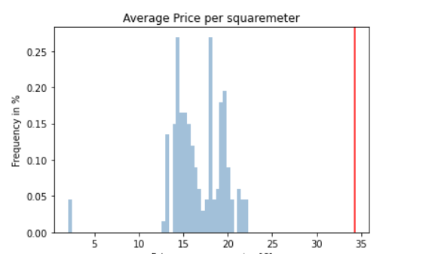
ANALYSIS OF APPARATMENTS AT MUNICH
John’s home has by far the highest price when compared to all other boroughs
No matter what john’s going to move, he will mostly likely find an apartment with lower price

Slide 5
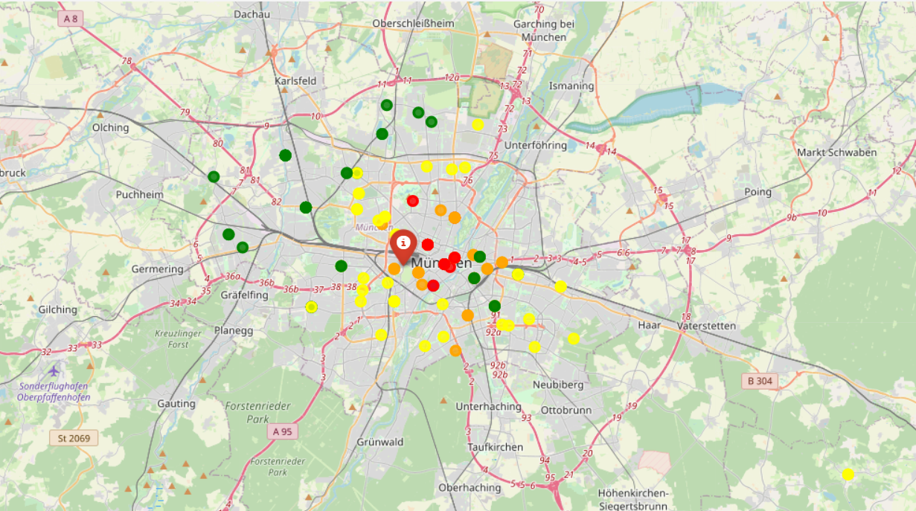
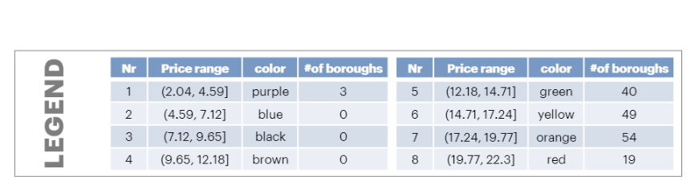
ANALYSIS OF PRICE DISTRIBUTION ACROSS MUNICH
This means if John would like to have cheap apartment he needs to move away from the center of Munich

Slide 6
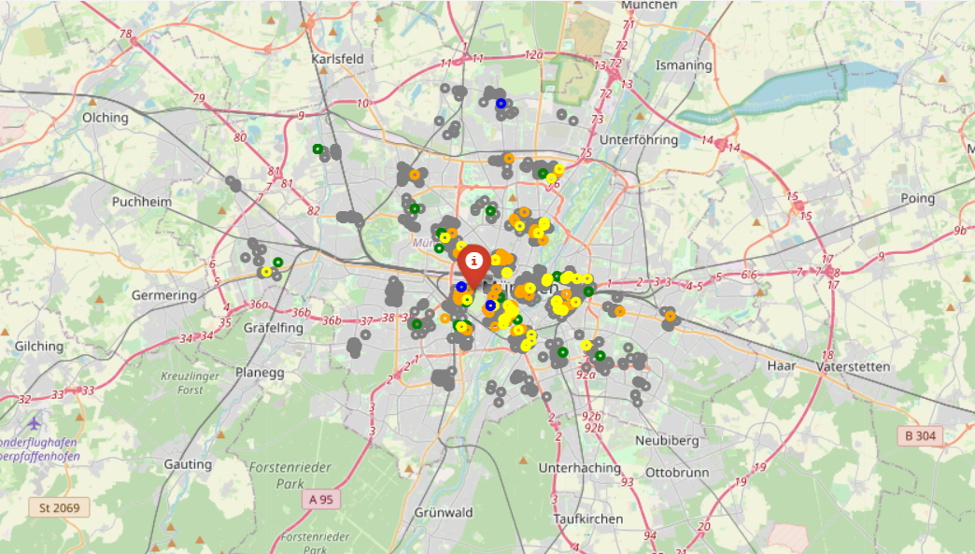
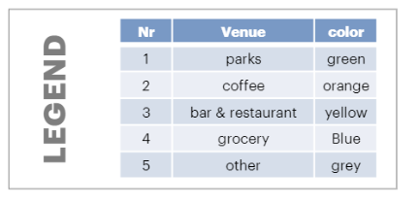
ANALYSIS OF VENUE DISTRIBUTION ACROSS MUNICH
Even though John lives in the perfect area to meet all of his requirements, there are a lot of promising neighborhoods as well

Slide 7
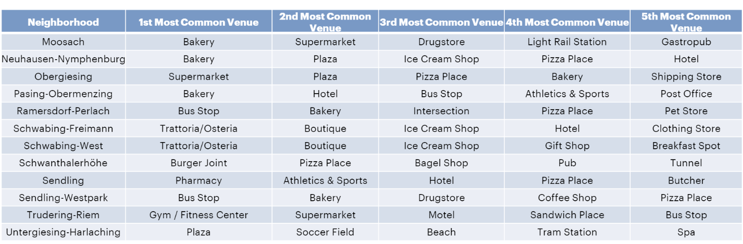
MOST COMMON VENUES IN THE BOROUGH OF MUNICH
John could explore all other boroughs before making a final decision

Slide 8
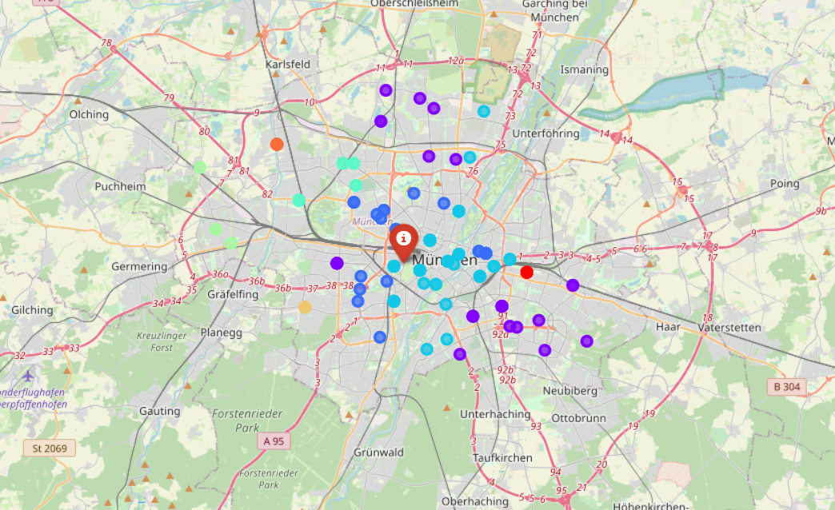
K MEANS IDENTIFIES MOST SIMILAR BOROUGHS TO JOHN’S CURRENT ONE
John should buy one of the eight areas highlighted in blue colour

Slide 9
RECOMMENDATION FOR JOHN
John should move to “Allach-Untermenzing” where he will find the cheapest price per square meter

